Slide 1
SUTD PostDoc Society Introduction
Senior Management Meeting
May 17, 2017

Slide 2
Structure
Office of Research (Assoc. Provost for Research, Martin L. Dunn)
SUTD PostDoc Society
All Postdoctoral Researchers at SUTD
Executive Committee
Committee members
Key personnel
Co-President
Co-President
Secretary
Treasurer
Advisory members for
Human Affairs
Outreach & Alumni
Professional Development
Socialising & Networking
Notes:
Office of research: Marty and Hsu Ann
Discussion sessions in April and July
Create an association for all PostDocs
Steering committee formed after the meetings
Key personnel to lead the activities
Advisory members to help with focus areas

Slide 3
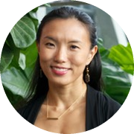
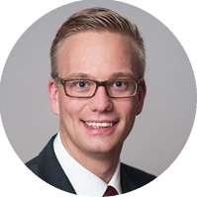
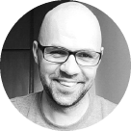
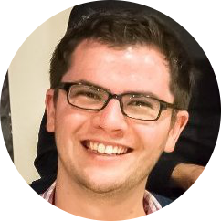
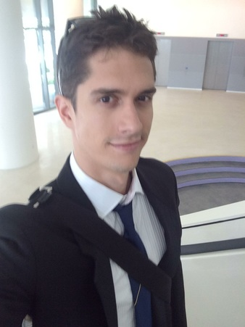
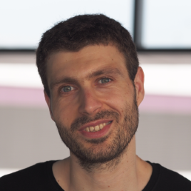
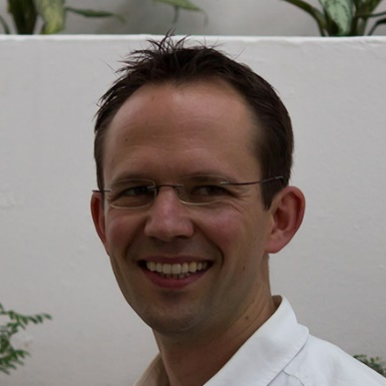
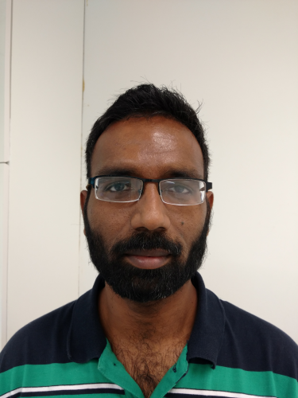
Committee Members
Co-President | Co-President | Secretary | Treasurer
Si-Hui Tan IDC / EPD Ph.D. in Physics Singapore | Oliver Weeger DManD Centre Ph.D. in Mathematics Germany | Paul Mignone IDC + DManD Centre Ph.D. in Mech.Eng. Australia | Chris Poskitt iTrust / ISTD Ph.D. in Comp.Sci. United Kingdom
Advisory committee members
David Collins | Hassan Hariri | Ulf Bissbort | Narasimha Boddeti
Notes:
Everyone briefly introduce themselves

Slide 4



What is a PostDoc?
PostDoc: Professional staff who conducts research after completing doctoral studies.
Supervise PhD students and RAs
Undertake project management, admin and teaching
Publish and write grants
Experts in their field
Research independenly
Goal: To transition to a faculty or an industry position.
Notes:
PostDocs have a broad role and various responsibilities (anecdotes)
Lack of awareness in SUTD admin, policies,
First action of the committee,
Meant for education of / interaction with members of SUTD and management & administration (justification)

Slide 5




Aims and Objectives
Foster a sense of community among PostDocs through networking activities
Create platform for exchange of ideas and collaboration
Advocate for PostDoc affairs and work with management
Career development workshops and events
Notes:
PostDocs not well-connected, no common spirit
Everybody for working for themselves, no inter-PostDoc collabs
Role and responsibilities of PostDocs not well-considered in admin policies and rules
PostDoc is temporal, we need preparation for the next step

Slide 6
Events and Activities
Weekly
Coffee hour
Social events
Attendance: 5-15 postDocs
Lunch
Monthly
Research Jam
Seminars with 3 short talks by PostDocs, Attendance: ~25 postdocs
Career development
Professional development events with faculty & industry speakers
Attendance: about 40 postdocs)
Pub & quiz nights
Social event, attendance: 5-15 PostDocs
Annually
Inaugural / annual meeting
First annual meeting in Oct 2016 to introduce the SUTD Postdoc Society.
Design Innovation Workshop
Workshop in February: series “Designing the SUTD Research Experience”
Attendance: ~20 participants

Slide 7
Activities and events
Research Jams (seminars with 3 short talks by PostDocs) (bi-monthly since December, usually ~25 participants)
Design Innovation workshop series “Designing the SUTD Research Experience” during February (~20 participants)
Professional development events with faculty & industry speakers (first one held on March 21, ~40 participants)
Weekly lunch and coffee hour, pub and quiz nights
Start interaction with management to advocate PostDoc interests and contribute to improvements
Join Employee Climate Survey improvement teams
PostDoc Survey (conducted in October, ~45% of around 160 PostDocs responded)
Notes:
Research Jam: connect PostDocs, disseminate expertise, and initiate collaboration
Design Innovation & professional development: skills and career development
Lunches, coffee & pub: socializing and connect PostDocs
Survey and management interaction: advocate PostDoc affairs and contribute to development & improvement of SUTD

Slide 8
SUTD PostDoc Survey

Slide 9
Survey Summary
Pain points
Affiliation of PostDocs
Administrative assistance
Facilties, IT, HR, Finance
Lack of acknowledgement of researchers, and general relationship among different staff groups
Actionables
Joining Employee Climate Survey task forces
Meeting with IT representatives

Slide 10
Priorities to address
Representation of PostDocs interests
Representation of PostDocs in management committees through the PostDoc Society to advocate PostDoc affairs
Ensure the PostDoc voice is heard for both existing and future issues
Clearly defining administrative assistance for PostDocs
Clearly defined Pillar / centre affiliations for PostDocs (e.g. iTrust vs. ISTD)
Provide PostDocs with clearly defined single points of contact (“gateways”) for admin assistance, whether through Pillar / centre admin assistants, PI secretaries, or dedicated admin assistant for PostDocs
Promote an understanding of the PostDoc role
Achieve more equality, independence, responsibility, and general consideration in admin policies and processes (e.g. seating arrangements, lab & room access, admin processes)
Currently in a chasm between PhD students and Faculty

Slide 11
Definition and Role of PostDocs
Postdoctoral researchers are professionals who conduct research after the completion of their doctoral studies.
PostDocs are highly-qualified academic staff members, who are scientific experts in their fields with demonstrated research experience and expertise. Although postdocs are in short-term positions, they are a vital part of the research body and essential contributors to SUTD’s core mission and international reputation.
They lead research activities on specific topics or projects and contribute a major portion of publications and grants. They work independently from their supervisors, guide and oversee the activities of PhD students and research assistants, and often take on project management, administrative and teaching duties.
The ultimate goal of many postdoctoral fellows is to pursue additional research, training, and teaching in order to broaden their skillset and prepare for an academic faculty position.
Notes:
PostDocs have a broad role and various responsibilities (anecdotes)
Lack of awareness in SUTD admin, policies,
First action of the committee,
Meant for education of / interaction with members of SUTD and management & administration (justification)

Slide 12
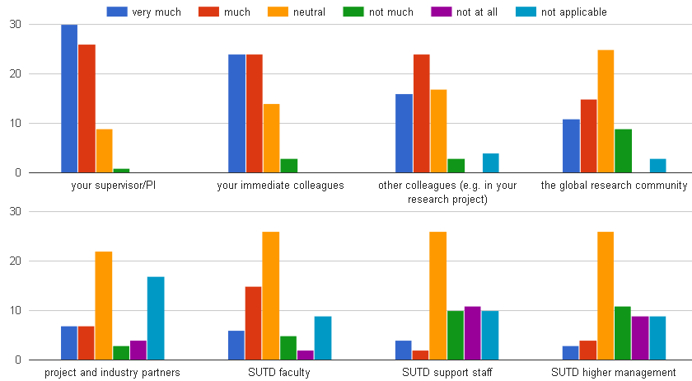
Feeling respected
Do you feel well respected and that you and your work are appreciated by ...?
1.29 1.06 0.88 0.47
#
* #
* #
0.23 0.33 -0.42 -0.36
* #
*
*
Remarks: * weakly positively correlated to overall satisfaction # weakly positively correlated to academic satisfaction
Number indicating average on a scale from -2 to 2
Notes:
Back-up for statement on slide 7 “PostDocs are mostly satisified with the academic conditions and the supervisors, but not feeling respected and neglected by admin staff and management”

Slide 13
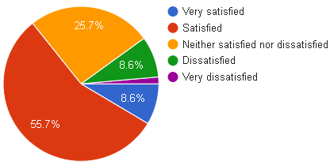
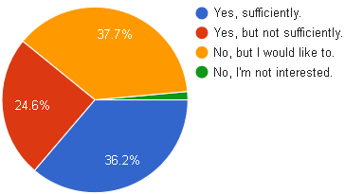
Academic / research situation
Do you have sufficient opportunities to interact or collaborate with other SUTD faculty, researchers & PhD students?
Satisfaction with academic situation
Remark: academic satisfaction strongly positively correlated overall satisfaction

Slide 14
Research situation comments
“Unfortunately, a lot of my time wasted for administrative and unnecessary rules and formalities in SUTD.”
“I have no chance to communicate with others ... Therefore, I feel quite alone here, and I am planning to leave. I know two other Postdocs, they are in the same situation. They also planning to leave. We have ambitions in academic, and we could learn much in SUTD. One year would be good to stay here. Staying more than two years, our research career will be definitely destroyed.”
“Postdocs at SUTD bear little to none consideration by a management that is mostly concerned about the good name of the University and their reputation rather than supporting academics and researchers”

Slide 15
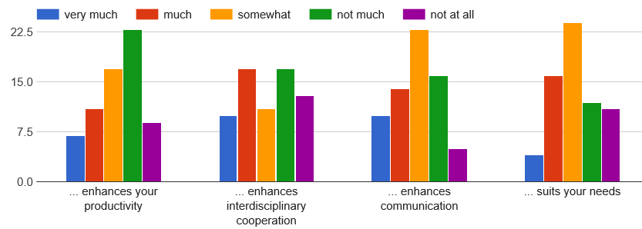
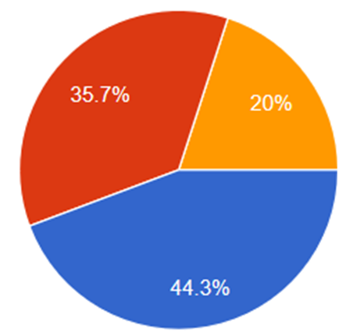
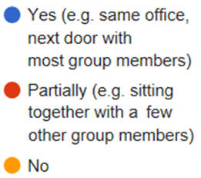
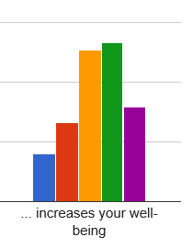
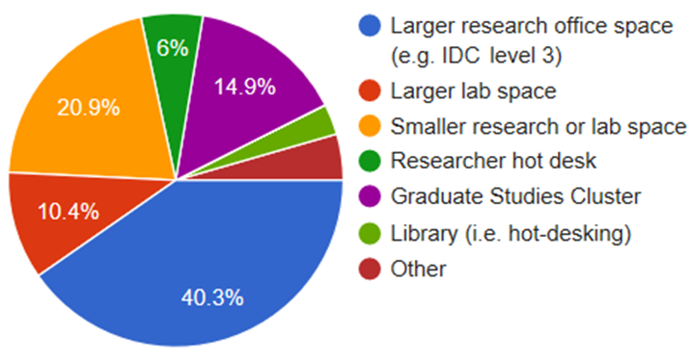
Office & lab environment
Do you feel that your office/lab environment ...?
Do you sit together with your supervisor's group / lab members?
-0.24 -0.09 0.12
Where are you seated?
0.15 -0.33

Slide 16
Supervisor Location (Cont’d)
If person answered “No” in previous slide: Does this impact your work, life, or integration at SUTD?
Relevant Comments
“Yes, I think being separated from the rest of my research group does not help for research/social interactions.”
“Not sitting with group leads to less communication, less assistance and friendship with peers”
“Actually, students, Ph.Ds and postdocs are separated from professors. This make us hard to meet any other professors to discuss…”
“…Nobody in the room is from my research team. Officemates don't connect with each other because a conversation disturbs 31 other people. The postdoc / GSC offices at SUTD really just feel like an "afterthought", and I don't find them conducive to productivity or community at all. In fact, I almost never use the office these days, preferring to work in the library.”

Slide 17
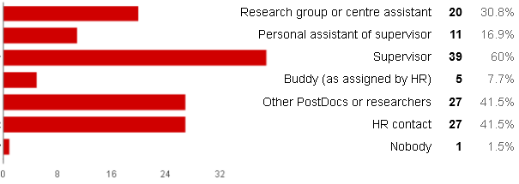
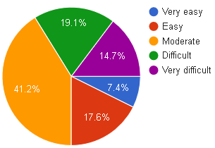
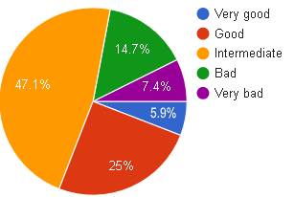
Administrative assistance
Points of contact for general administrative assistance
How easy is it to find help for administrative issues?
Overall rating of administrative support received

Slide 18
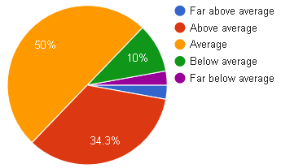
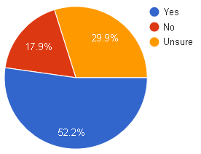
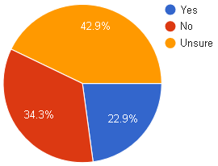
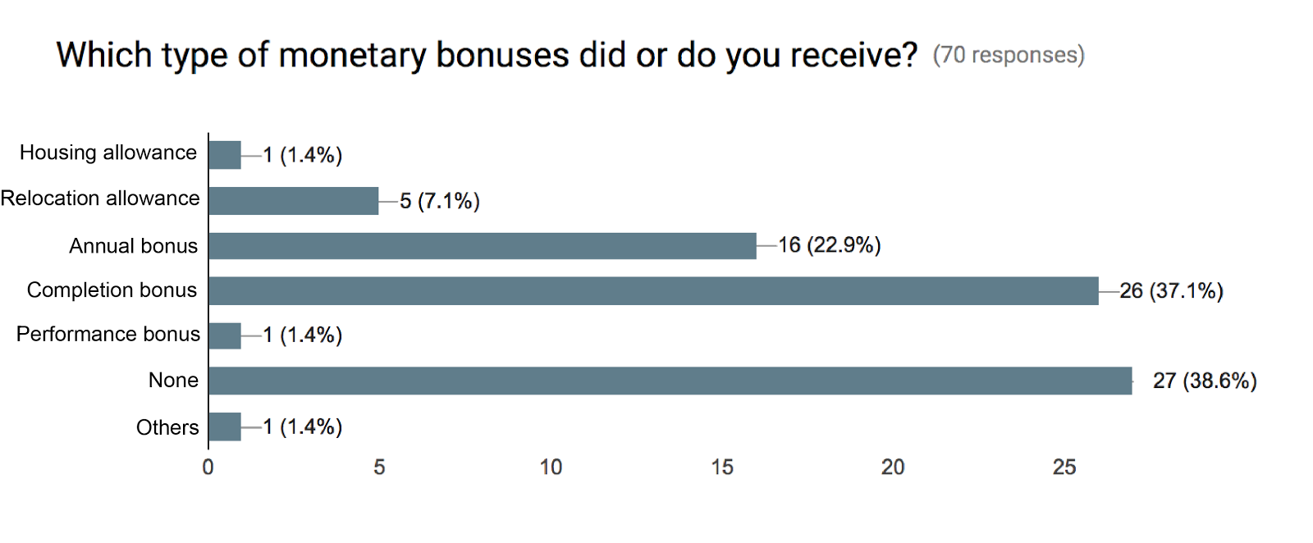
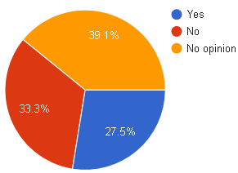
Salary & bonuses
Rating of salary & bonus package
Favour a monetary compensation scheme coupled to KPIs?
Do you find the compensation scheme transparent?
Types of monetary bonuses received
Satisfied with bonuses received?

